Slide 1
Chapter 20. Network Layer: Internet Protocol
20.1 Internetworking
20.2 IPv4
20.3 IPv6

Slide 2
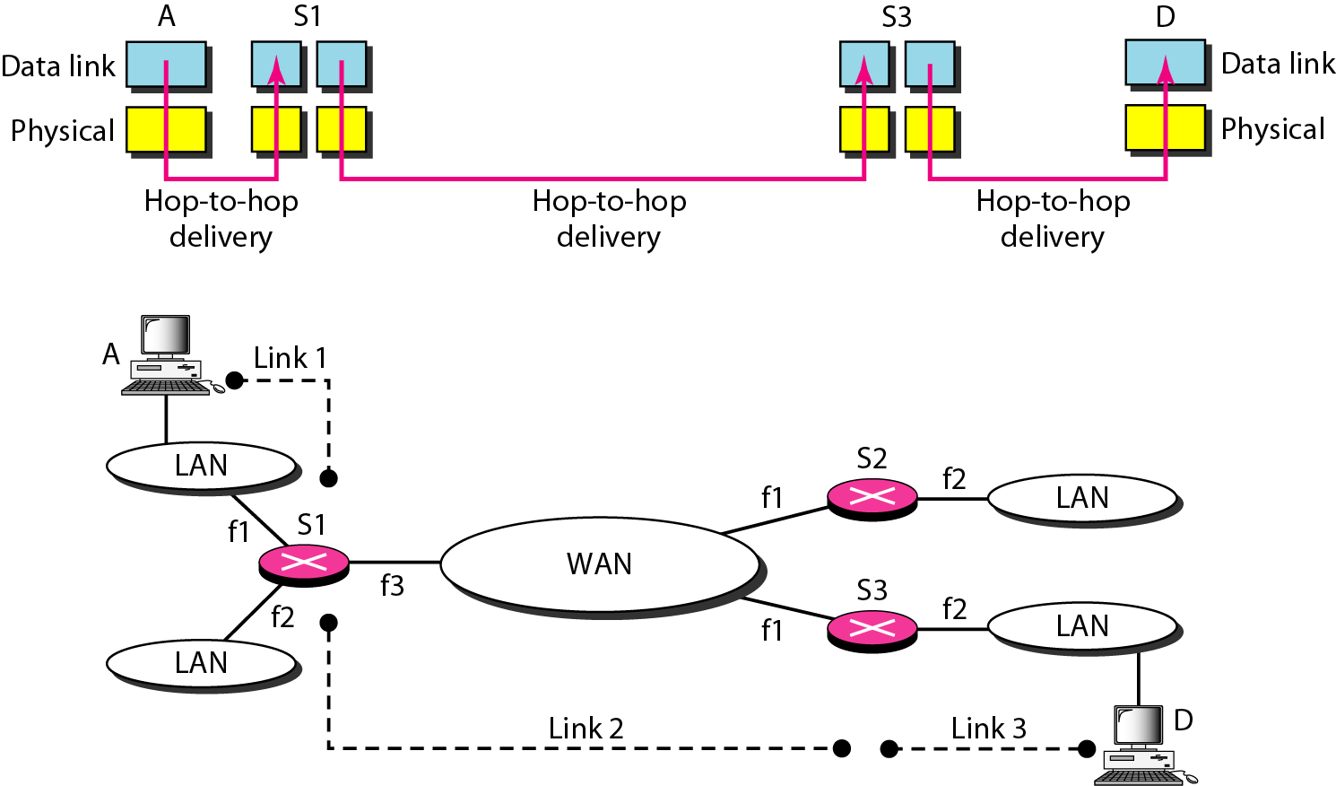
Link Layer Interconnection
Frame in data link layer does not carry any routing information
Problem: How does S1 know that data should be sent out from interface f3 ?

Slide 3
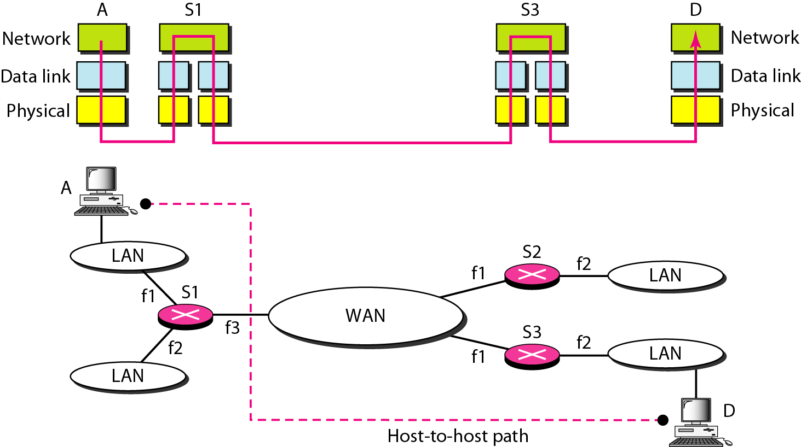
Network Layer in an Internetwork
Network layer is responsible for host-to-host delivery and for routing the packets

Slide 4
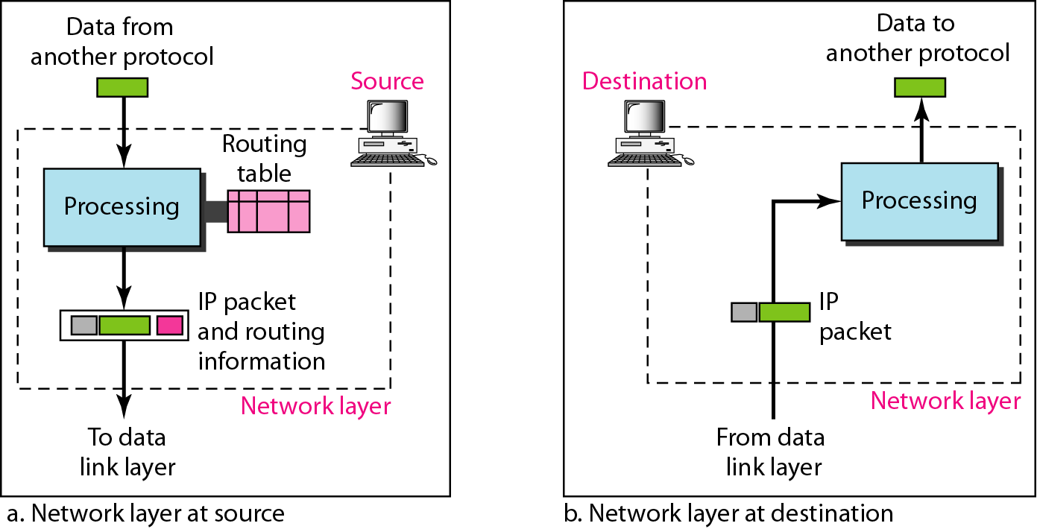
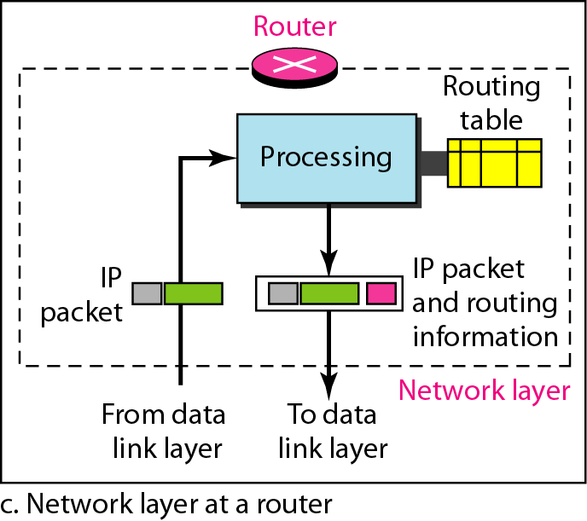
Network Layer

Slide 5
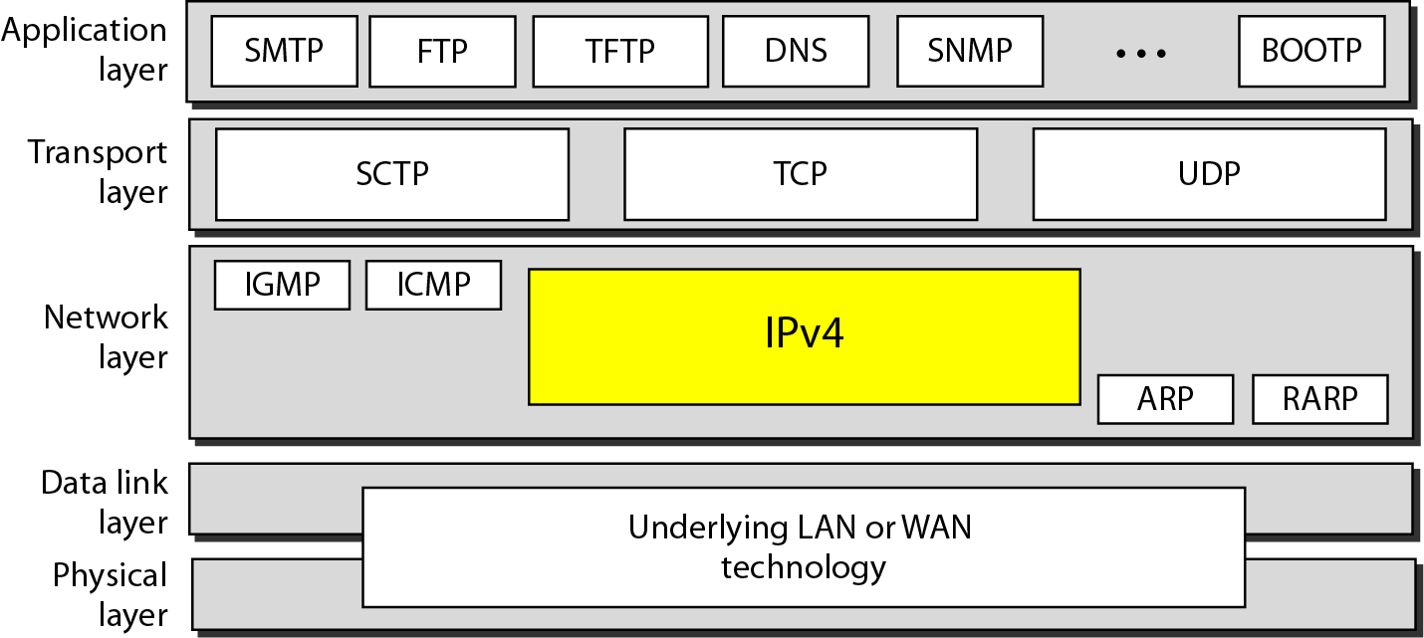
Internet Protocol (IP)
Switching at the network layer in the Internet uses the datagram approach
Communication at the network layer in the Internet is connectionless
Position of IPv4 in TCP/IP protocol suite

Slide 6
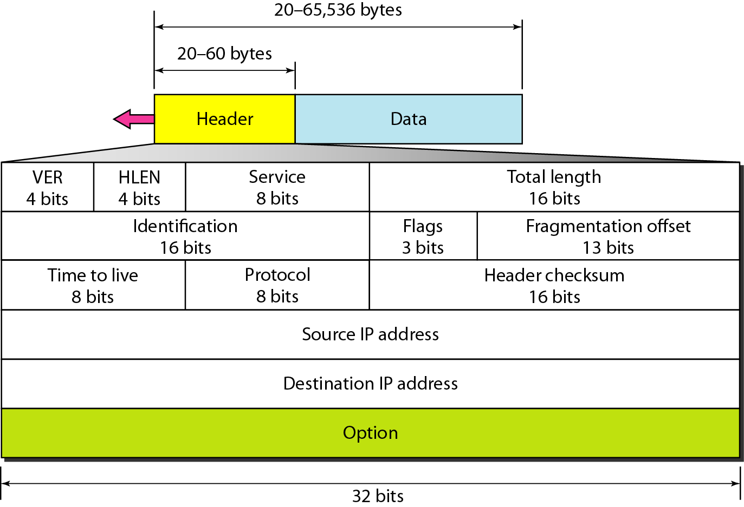
IPv4 Datagram

Slide 7
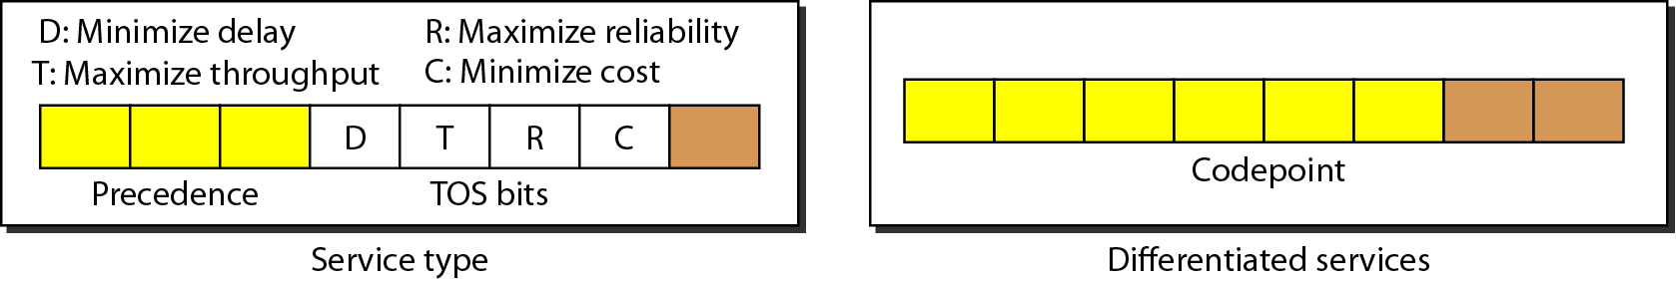
IPv4 Header
Version: IPv6, IPv4
Service type or differentiated services
Precedence: never used
TOS

Slide 8
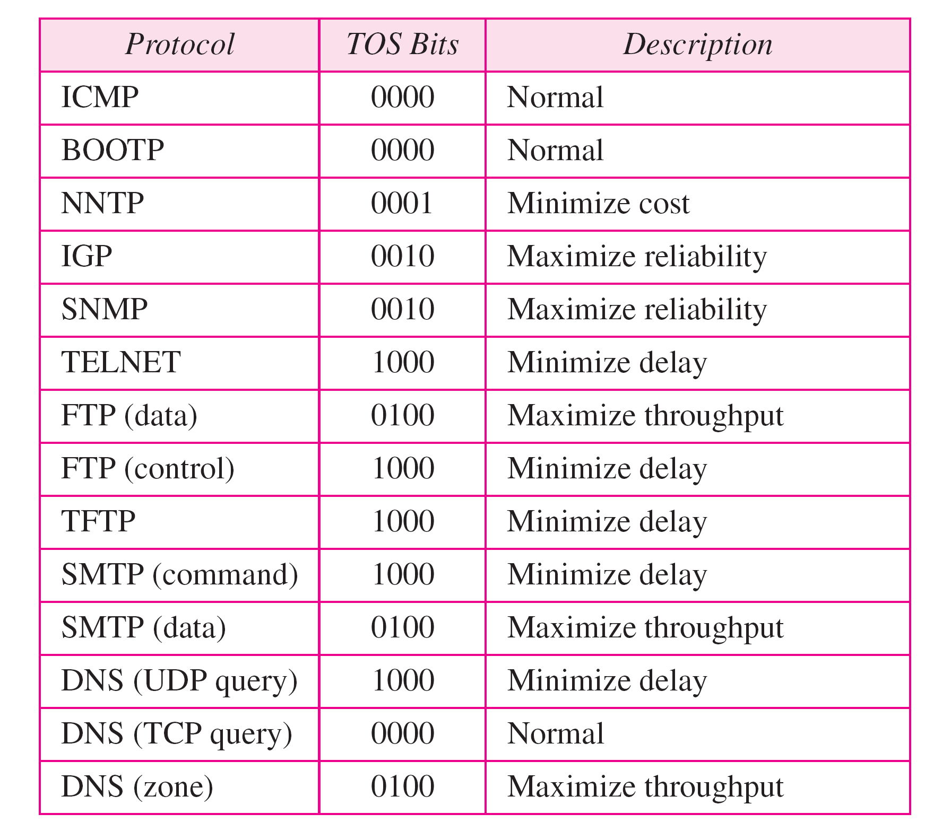
Default TOS for Applications

Slide 9
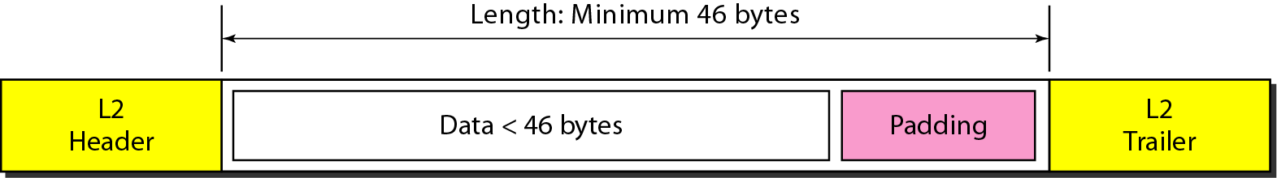
IPv4 Header
Total length: Length of data = total length – header length
Maximum 65535 (2¹⁶ – 1) bytes
Encapsulation of a small datagram in an Ethernet frame
Identification: used in fragmentation
Flag : used in fragmentation
Fragmentation offset
Time to live
Checksum
Source and destination address

Slide 10
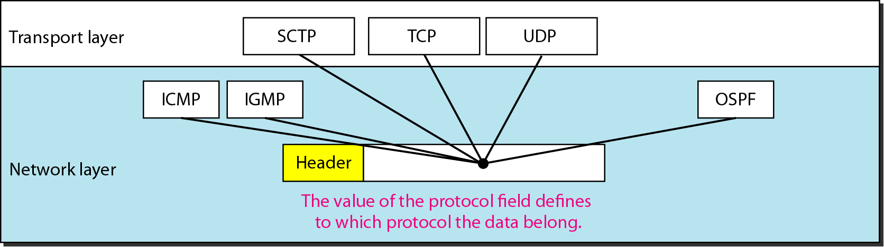
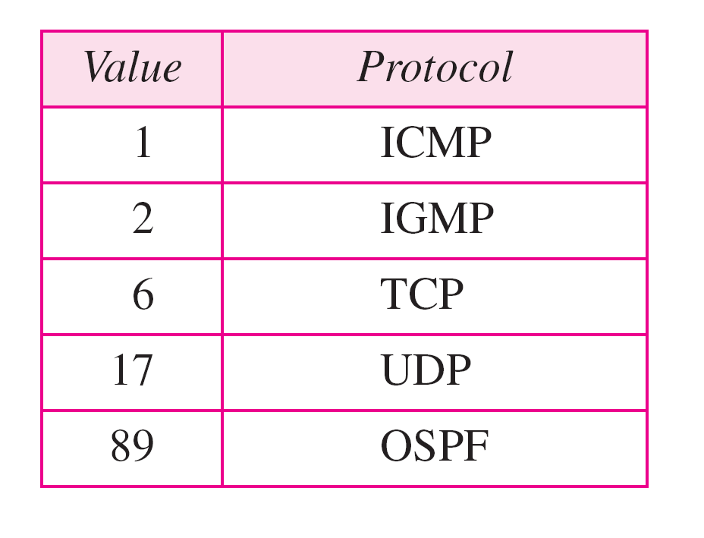
IPv4 Header
Protocol field for higher-level protocol

Slide 11
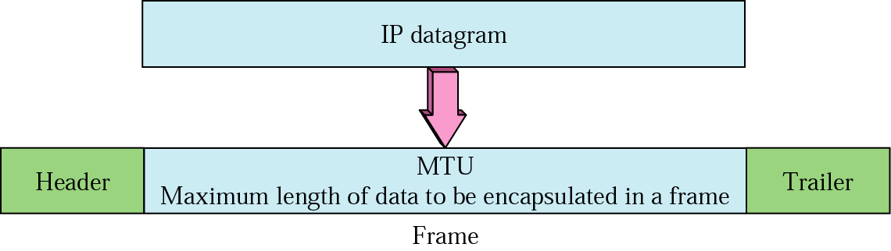
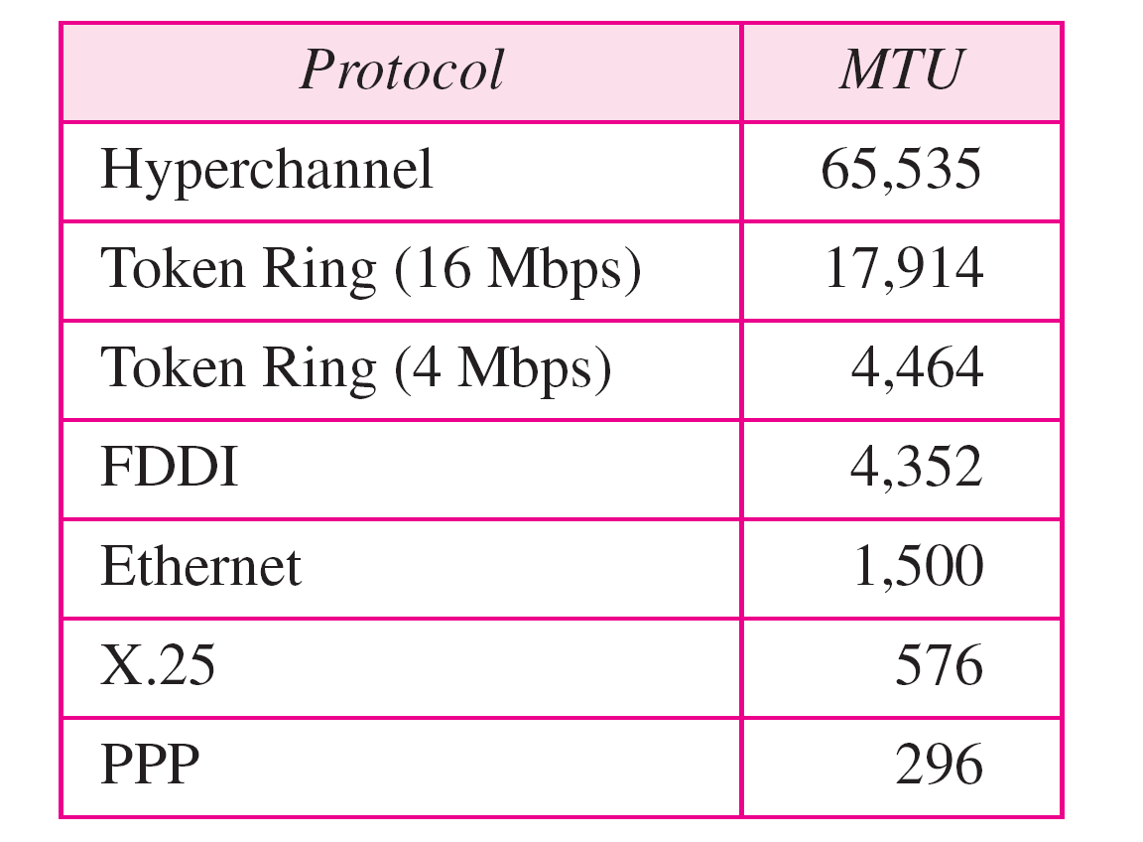
Fragmentation
Maximum length of the IPv4 datagram: 65,535 bytes

Slide 12
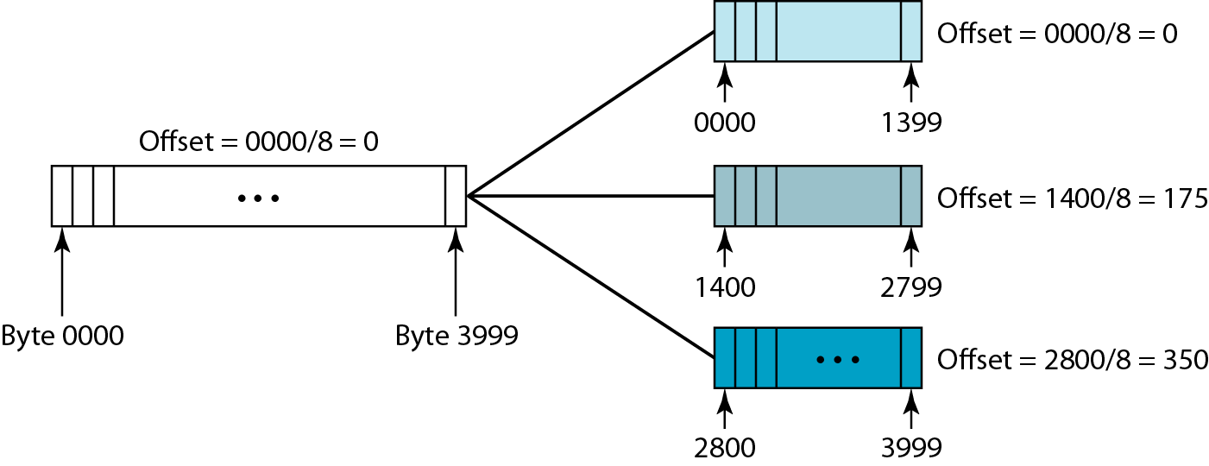
Field related to fragmentation
Identification: identifies a datagram originating form the source host
Flags: the first bit (reserved), the second bit (do not fragment bit), the third bit (more fragment bit, 0 means this is the last or only fragment)
Fragmentation offset: (13 bits cannot represent a sequence of bytes greater than 8191

Slide 13
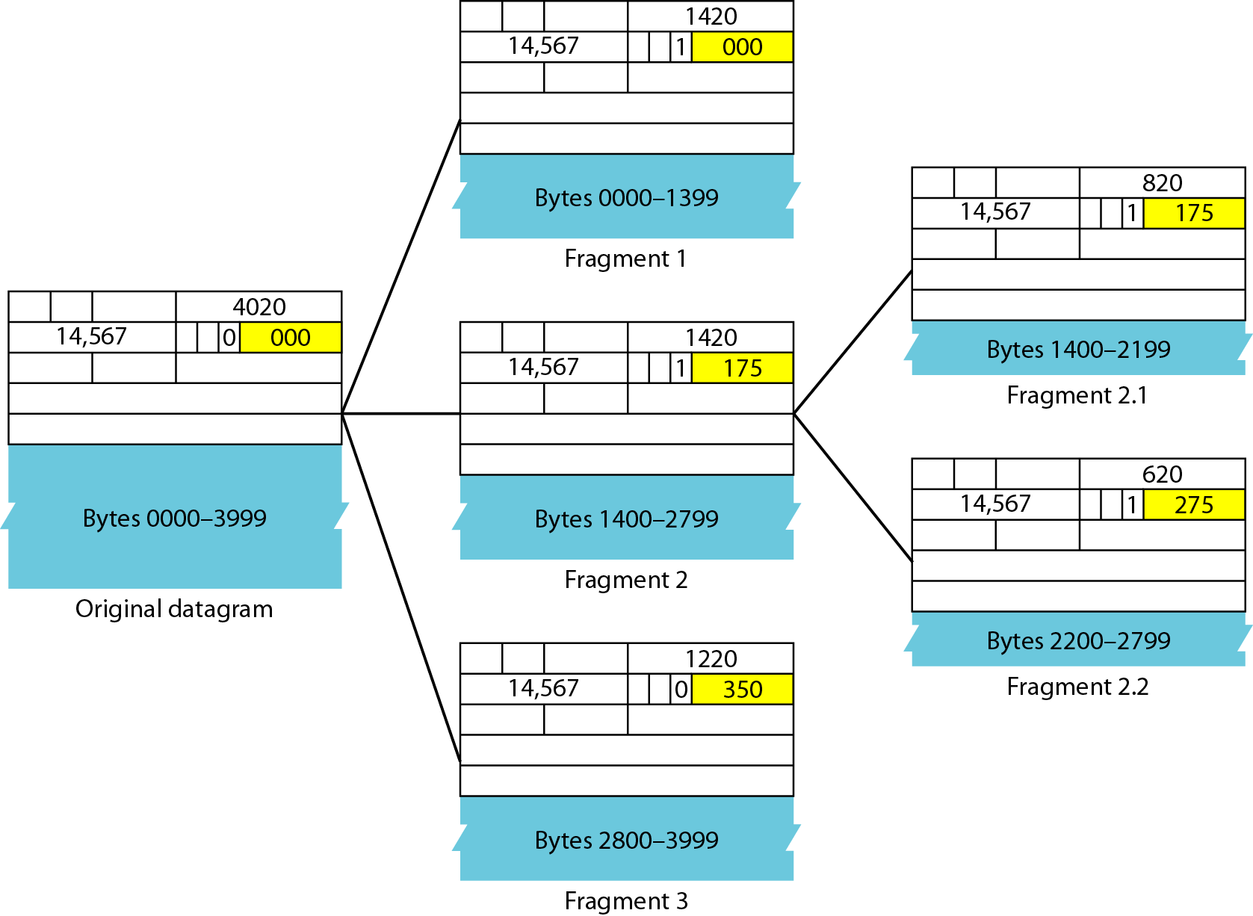
Detailed Fragmentation Example

Slide 14
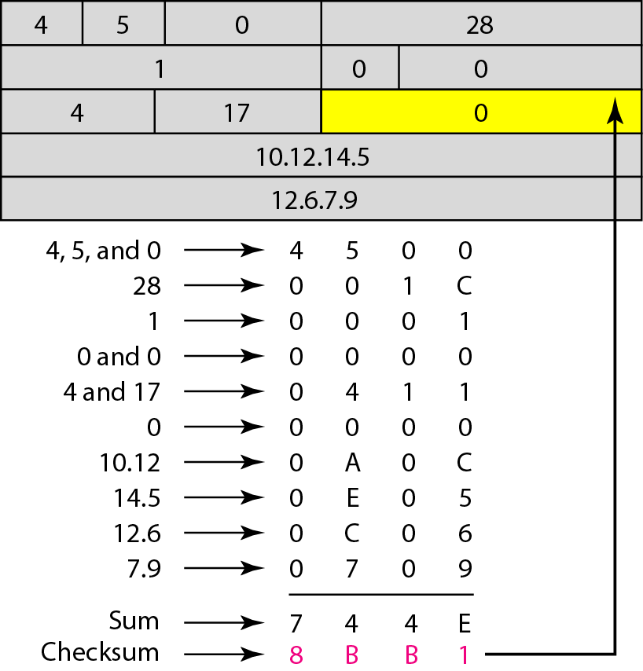
Checksum

Slide 15
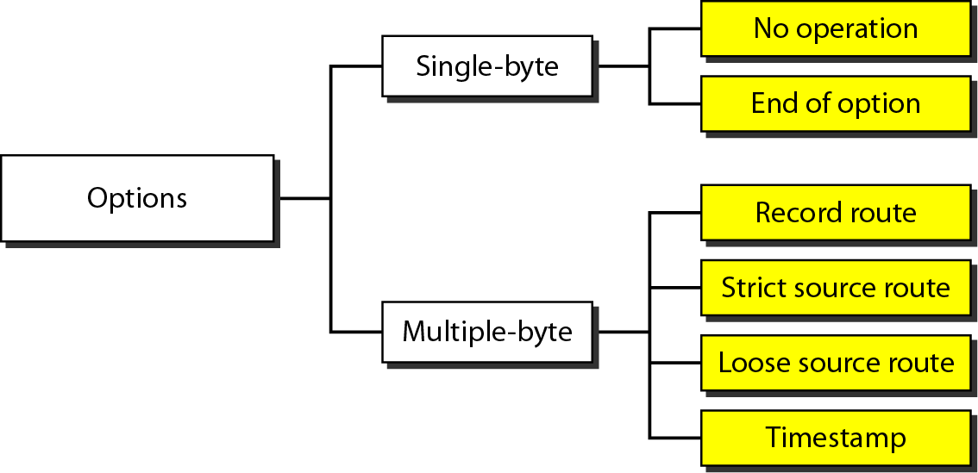
Options
IPv4 header is made of two part: a fixed part and a variable part
Fixed part: 20 bytes long
Variable part comprises the options that can be a maximum of 40 bytes

Slide 16
IPv6 address
The use of address space is inefficient
Minimum delay strategies and reservation of resources are required to accommodate real-time audio and video transmission
No security mechanism (encryption and authentication) is provided
IPv6 (IPng: Internetworking Protocol, next generation)
Larger address space (128 bits)
Better header format
New options
Allowance for extention
Support for resource allocation: flow label to enable the source to request special handling of the packet
Support for more security

Slide 17
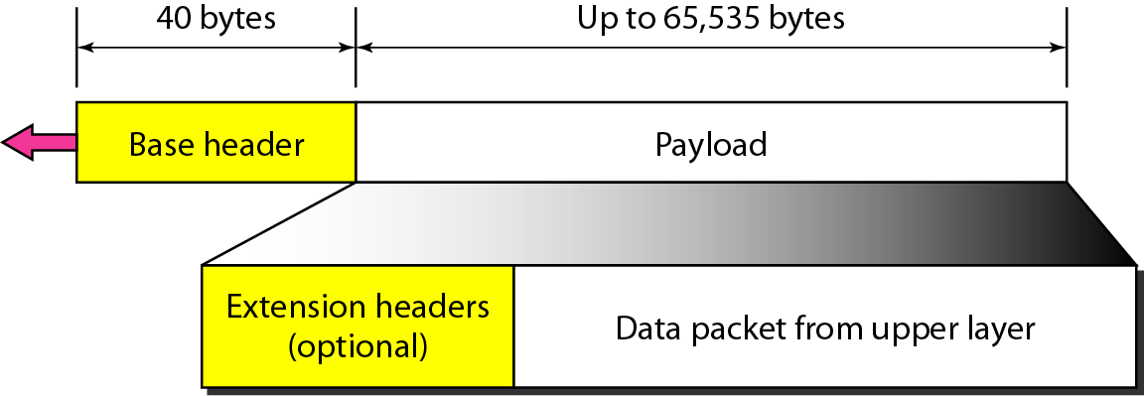
IPv6 Datagram
IPv6 defines three types of addresses: unicast, anycast (a group of computers with the same prefix address), and multicast
IPv6 datagram header and payload

Slide 18
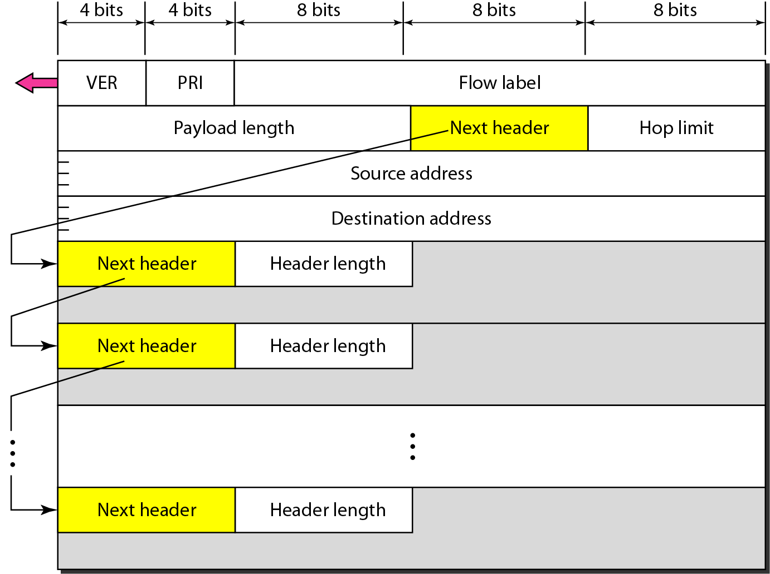
IPv6 Datagram Format

Slide 19
IPv6 Header
Version: IPv6
Priority (4 bits): the priority of the packet with respect to traffic congestion
Flow label (3 bytes): to provide special handling for a particular flow of data
Payload length
Next header (8 bits): to define the header that follows the base header in the datagram
Hop limit: TTL in IPv4
Source address (16 bytes) and destination address (16 bytes): if source routing is used, the destination address field contains the address of the next router

Slide 20
Priority
IPv6 divides traffic into two broad categories: congestion-controlled and noncongestion-controlled
Congestion-controlled traffic
Noncongestion-controlled traffic

Slide 21
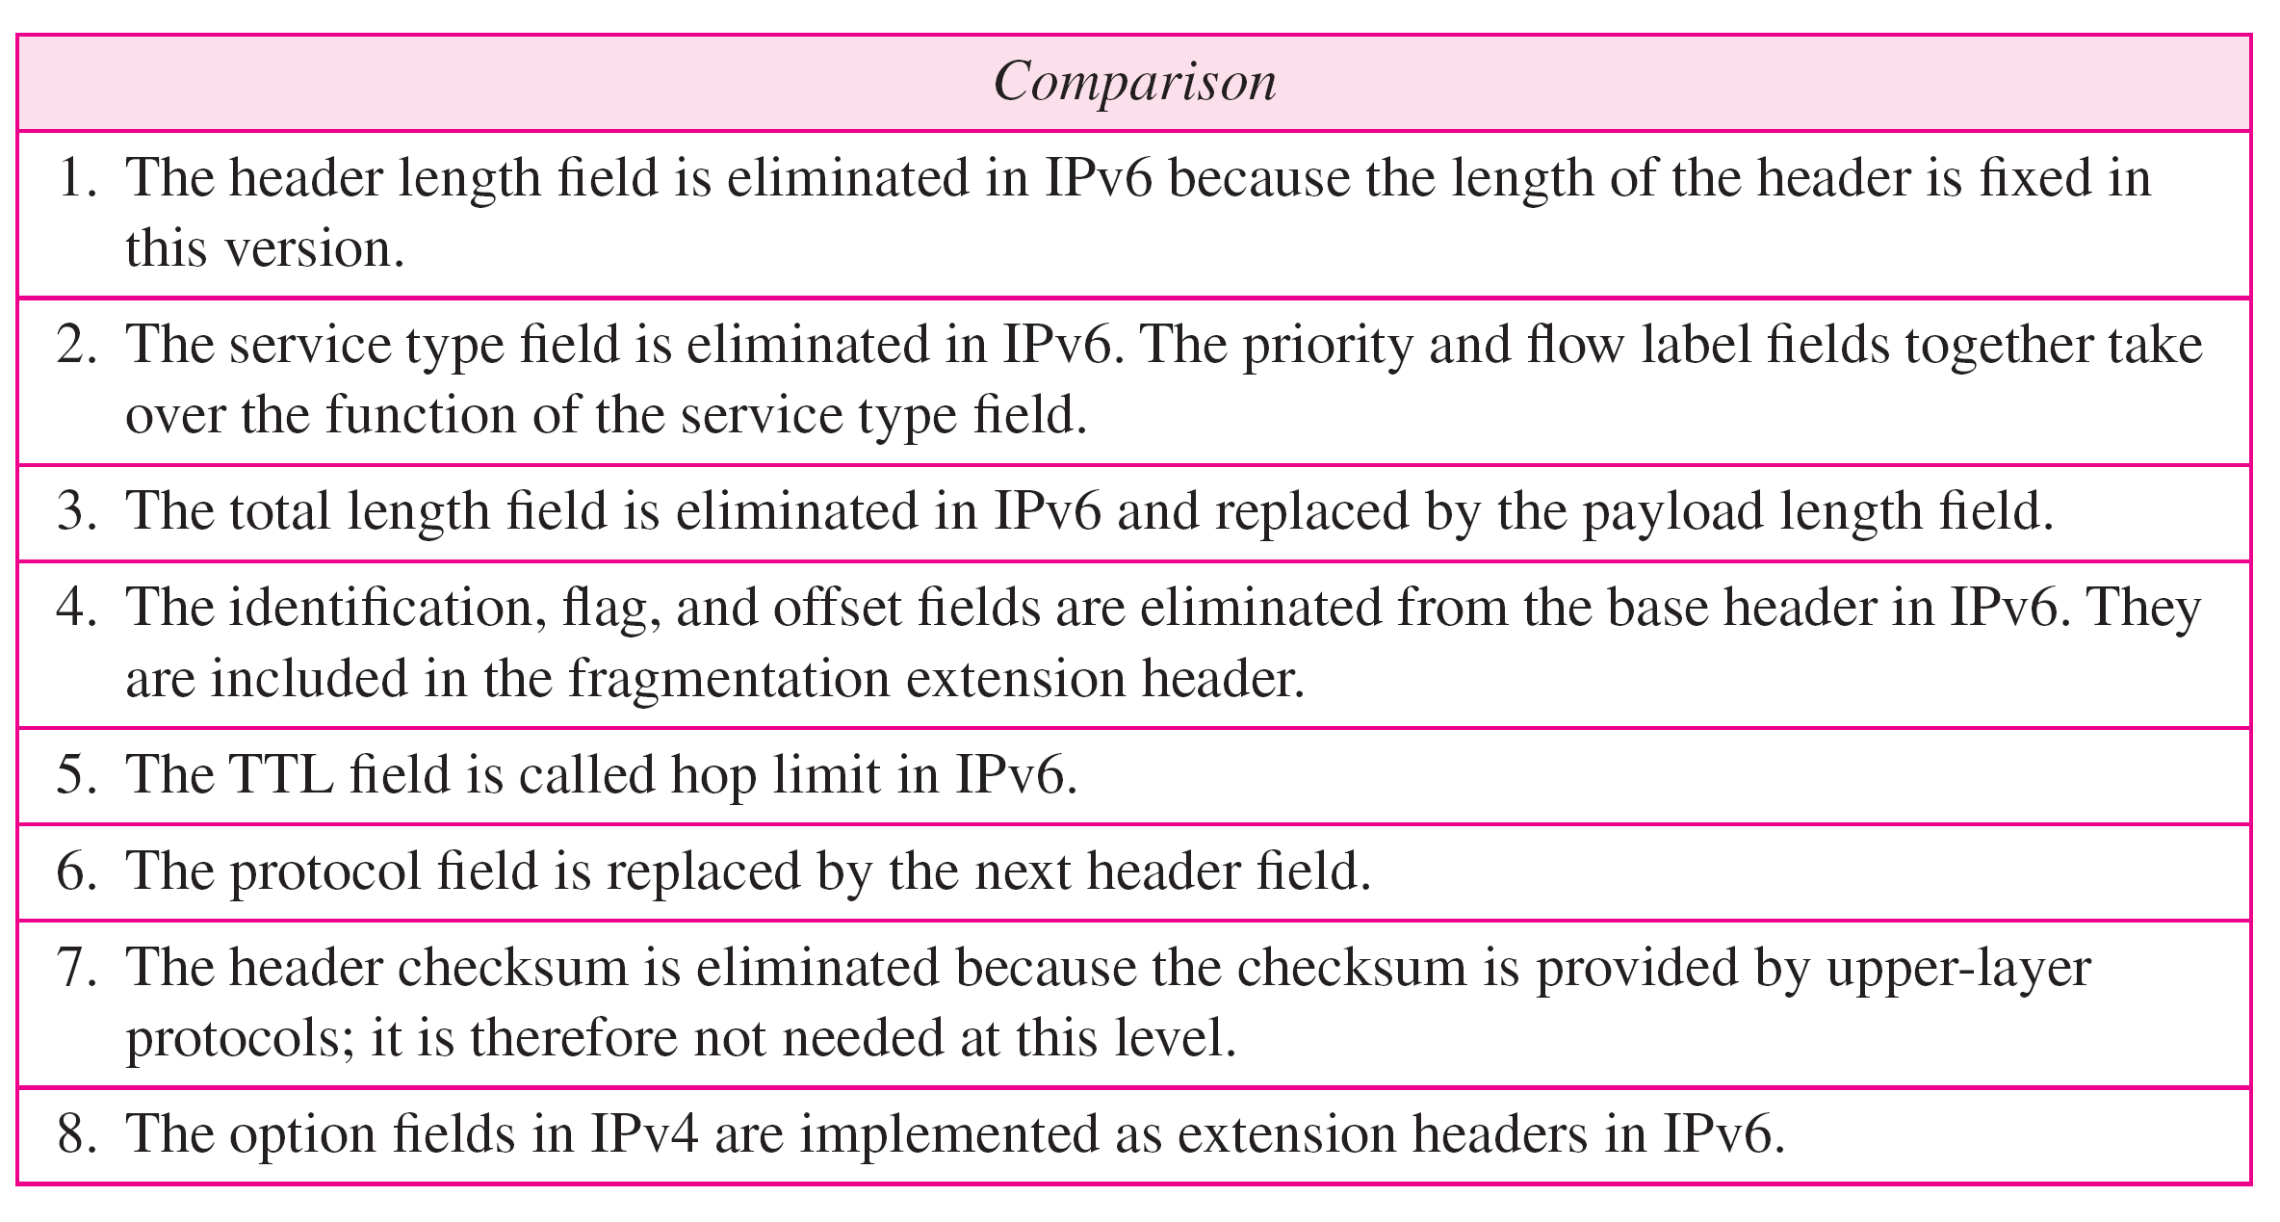
Comparison between IPv4 and IPv6

Slide 22
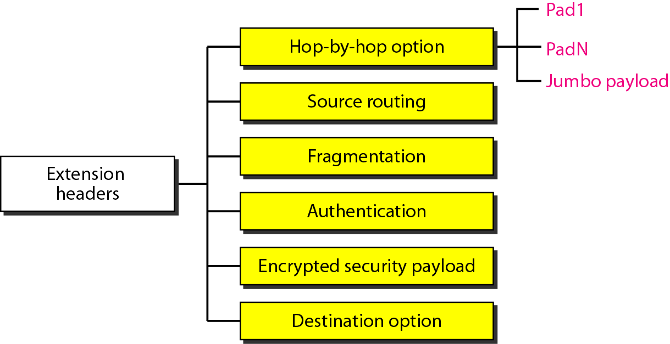
Extension Header

Slide 23
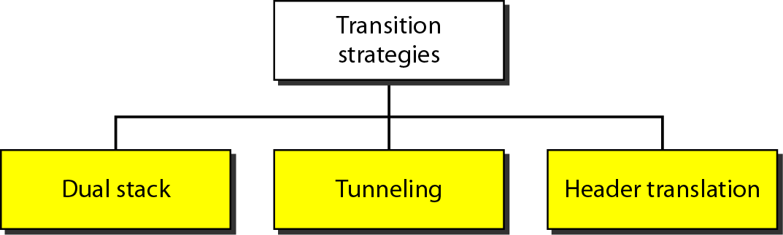
Three transition strategies from IPv4 to IPv6
Transition should be smooth to prevent any problems between IPv4 and IPv6 systems

Slide 24
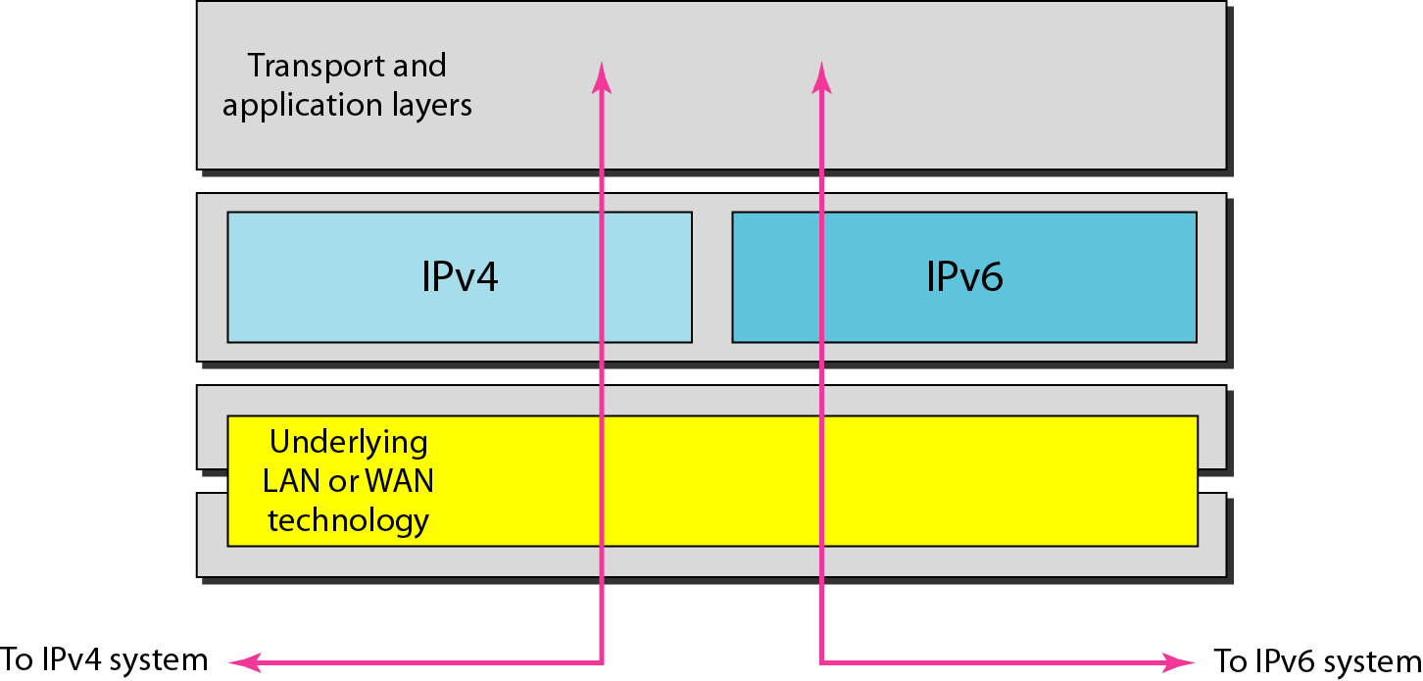
Dual stack
All hosts have a dual stack of protocols before migrating completely to version 6

Slide 25
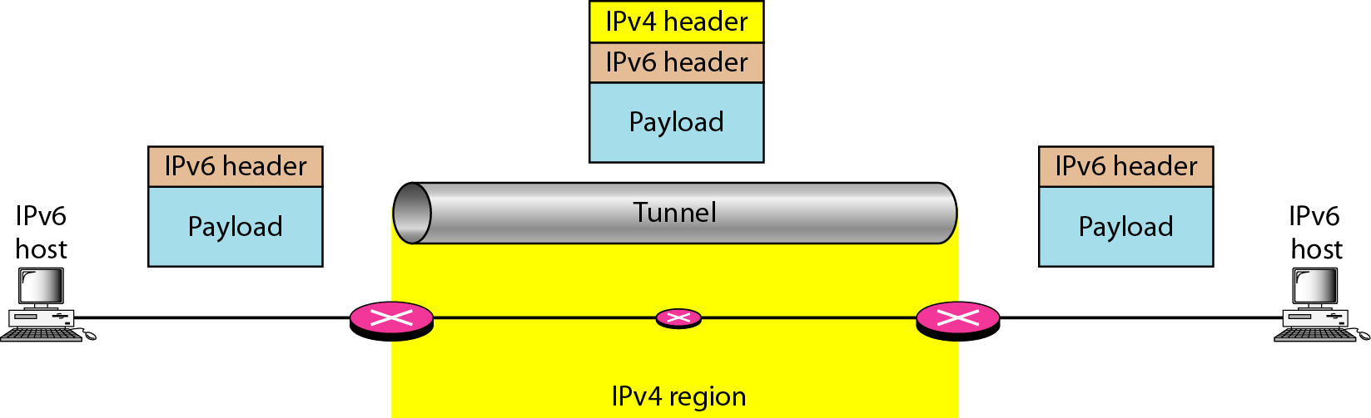
Tunneling
IPv6 packet is encapsulated in an IPv4 packet

Slide 26
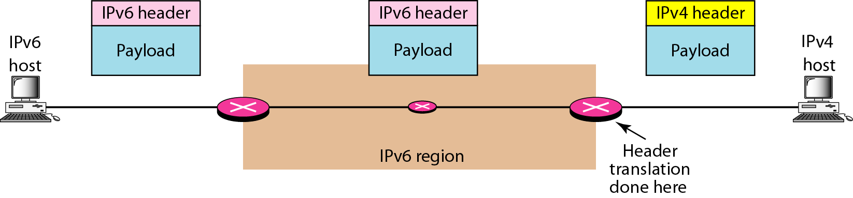
Header translation
Necessary when the majority of the Internet has moved to IPv6 but some systems still use IPv4
Header format must be changed totally through header translation

